Slide 1
Real world analysis 3

Slide 2
Stuff you asked for
Ancova with baseline
Anova for pre-post change scores
Anova 2x2 between subjects
Hierarchical multiple regression
Regression to test moderation
Post-hoc contrasts between groups
Multiple comparisons
Cohen's D for group differences
Independent samples t test, Paired sample t test
Mann Whitney U
Chi square to test contingency table
Levene's test (equality of variances)
Cronbach's alpha

Slide 3
Hierarchical regression
Anova is one type of hierarchical regression
AKA Model comparison:
Is Y ~ A + B any worse than Y ~ A * B?
F-test for the comparison between models
Often to deal with sets of predictors
Should report F test and Rsquared in APA style

Slide 4
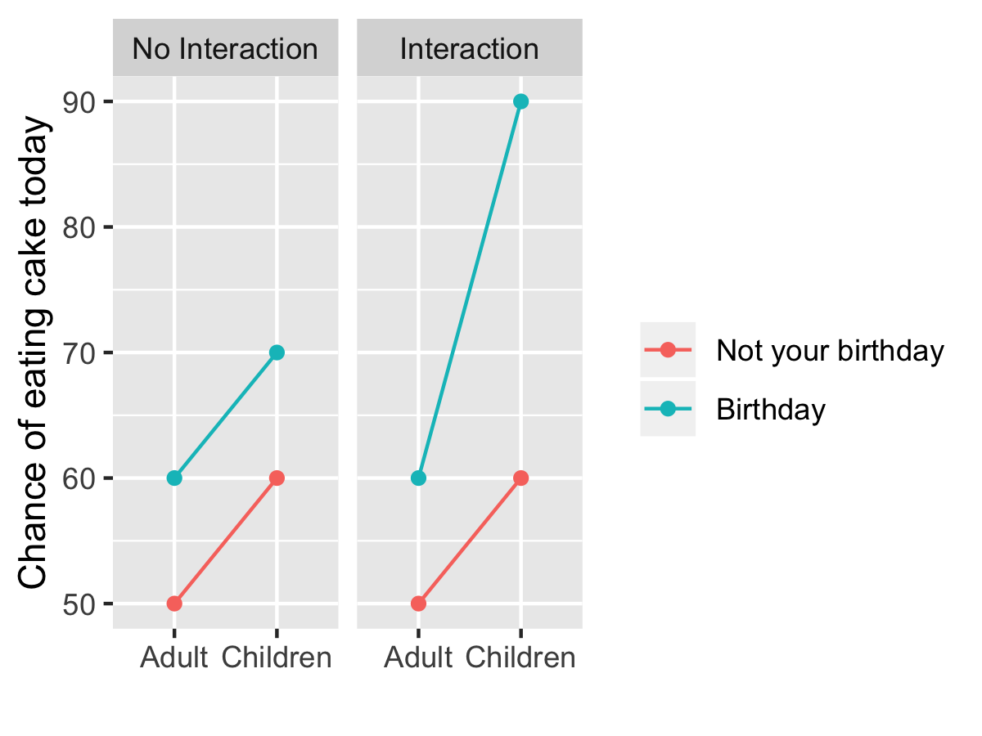
Moderation
What does moderation mean?
“Effect of A only happens with B also happens” or
“Effect of A is much bigger when B also present”

Slide 5
Seen this before…
lm(y ~ A * B… )
F test:
car::Anova(model)
BF for the interaction:
m1 <- lmBF( outcome ~ A + B, data=df)
m2 <- lmBF( outcome ~ A * B, data=df)
m2/m1

Slide 6
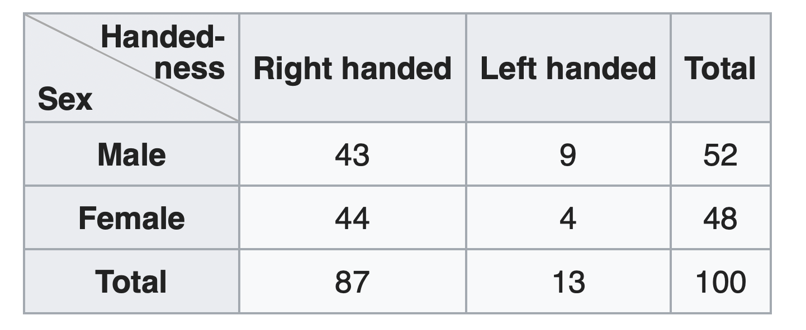
emmeans for followup tests emmeans … short for estimated marginal means marginal = “averaging across other factors”

Slide 7
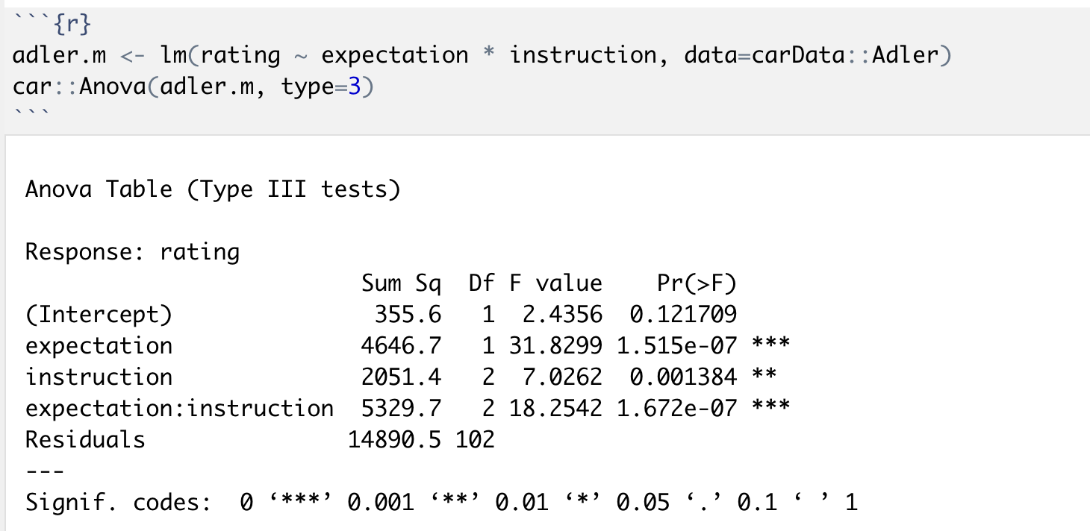
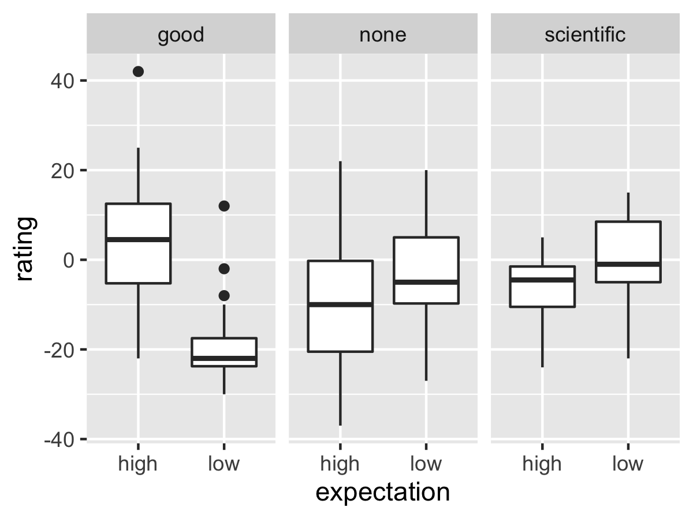
emmeans for followup tests emmeans = estimated marginal means marginal = “averaging across other factors”

Slide 8
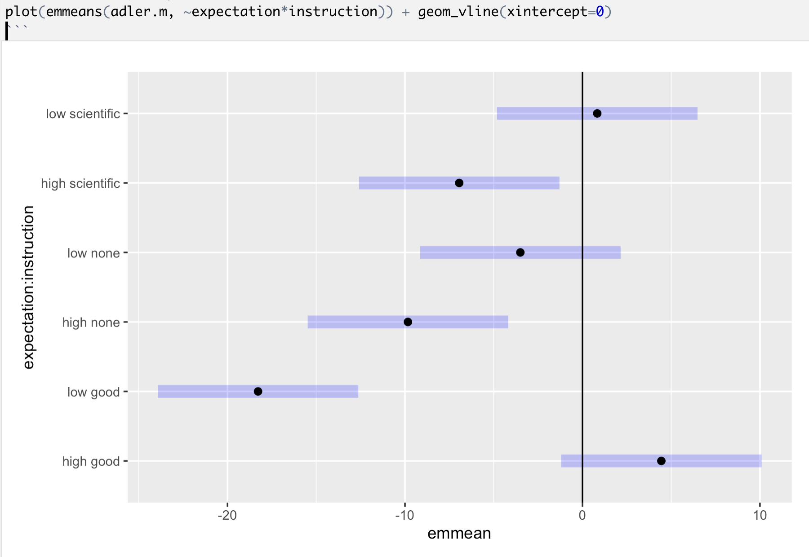
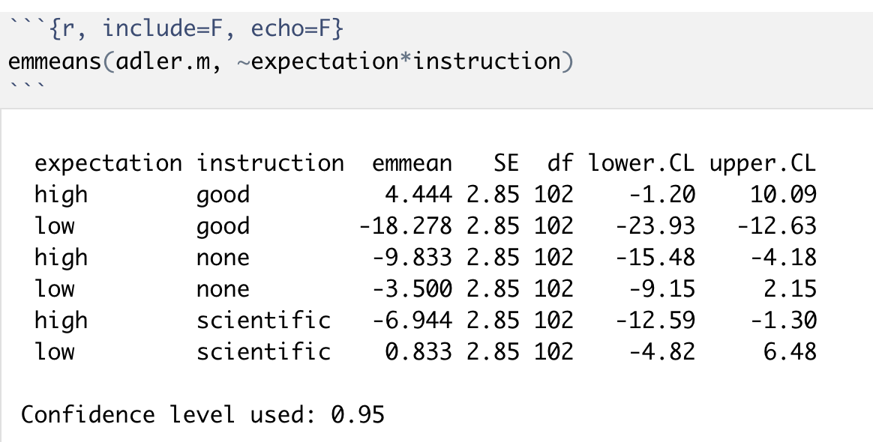
All cell means

Slide 9
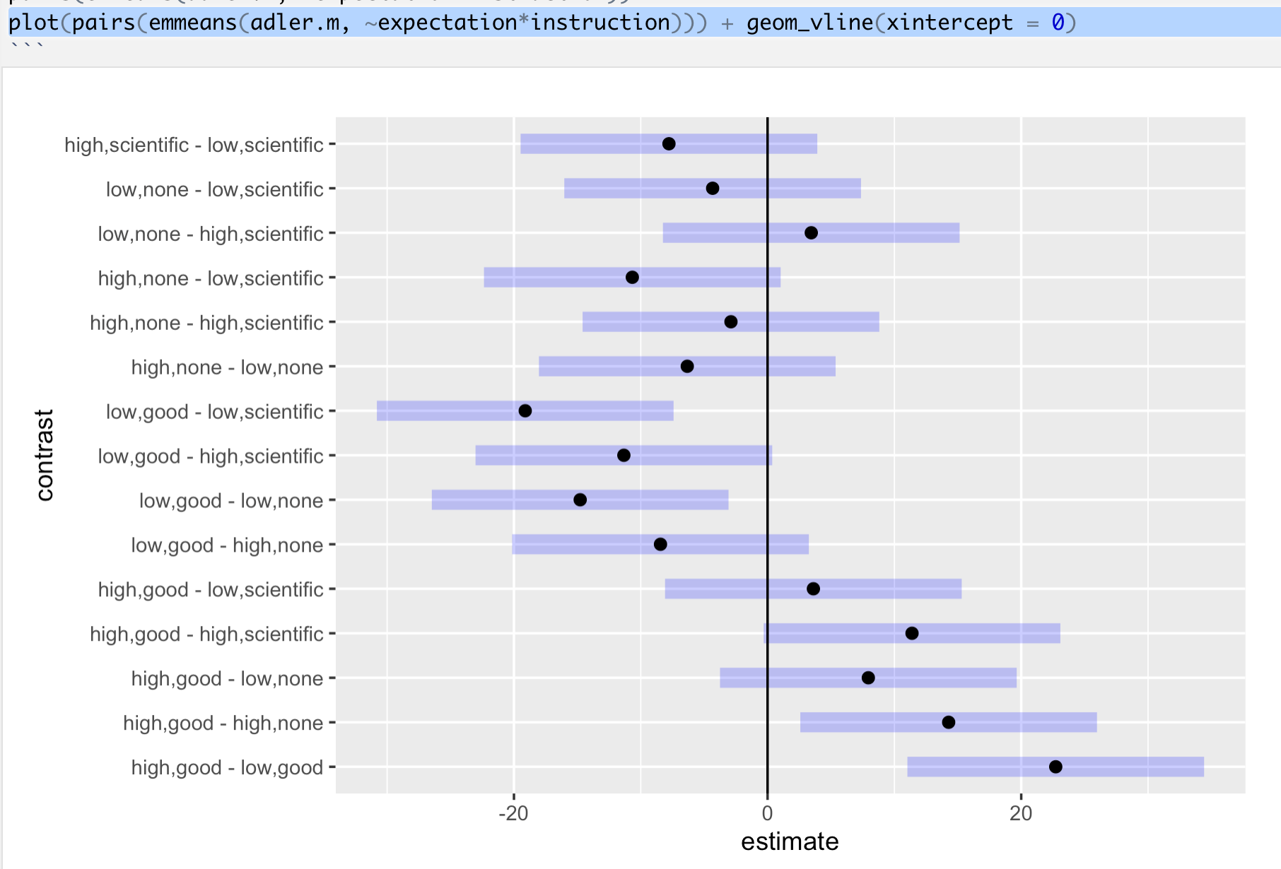
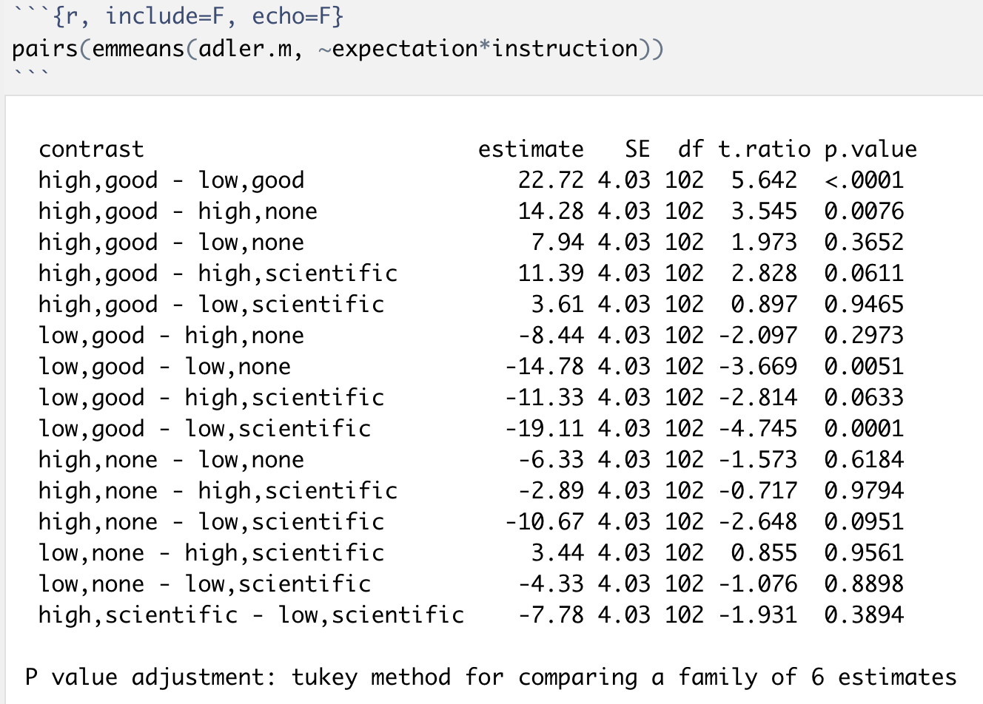
All pairwise contrasts

Slide 10
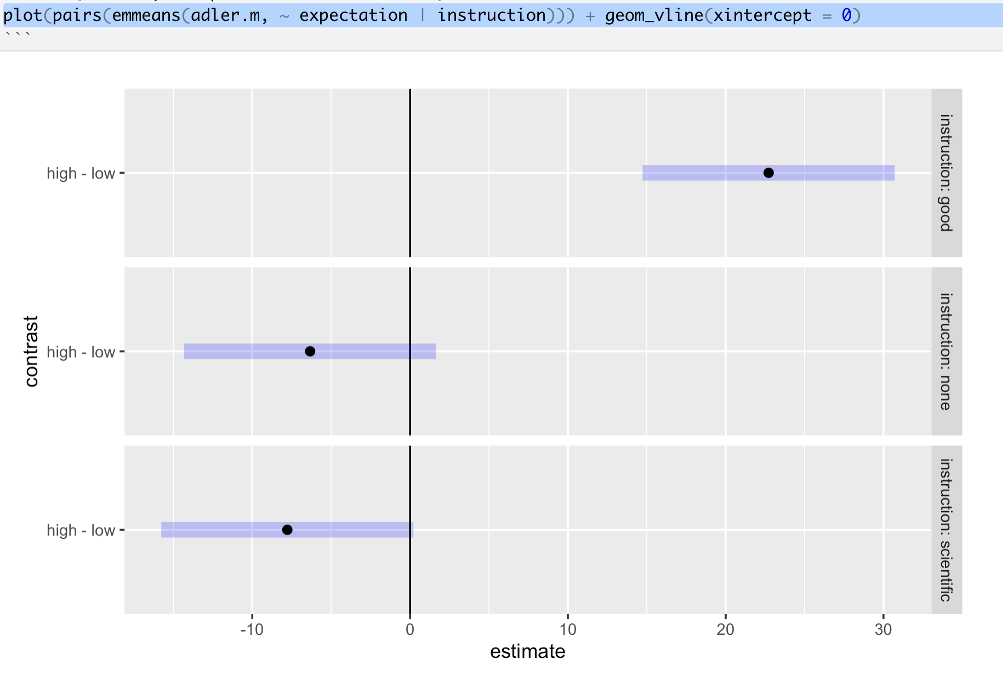
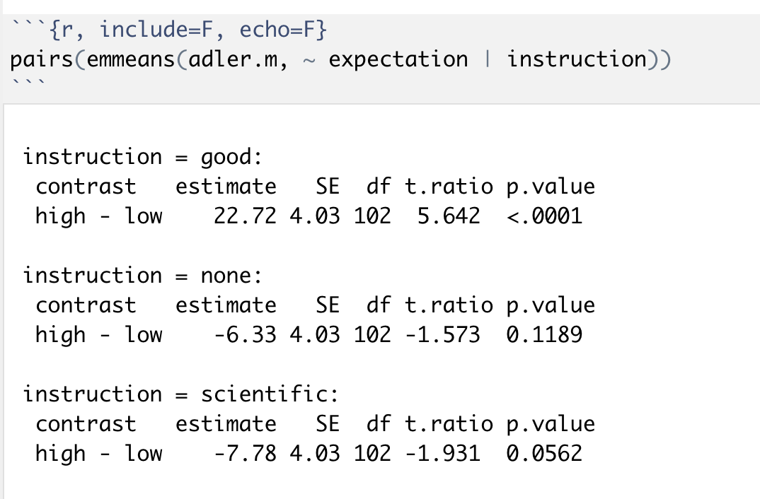
Differences within instruction

Slide 11
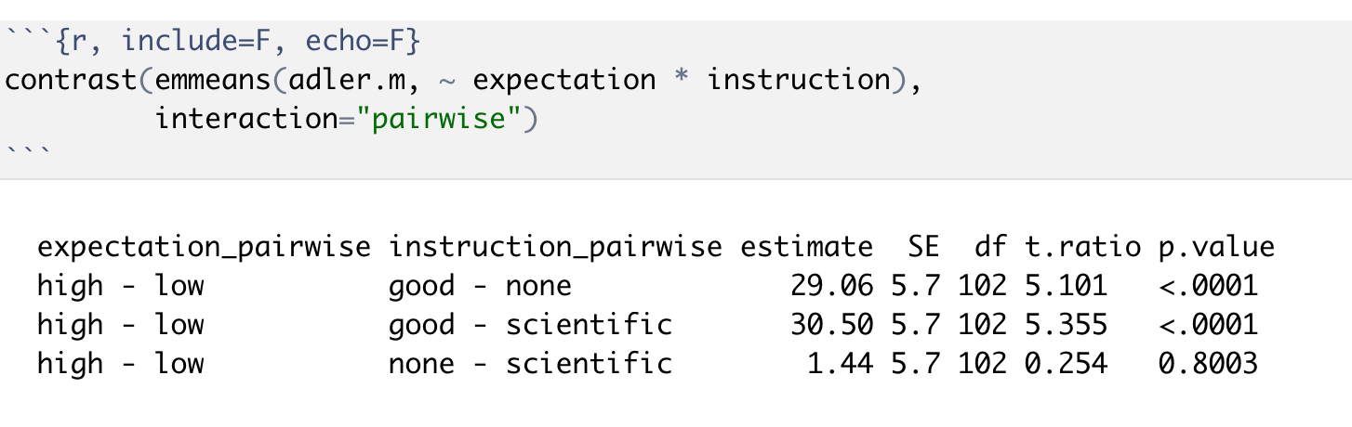
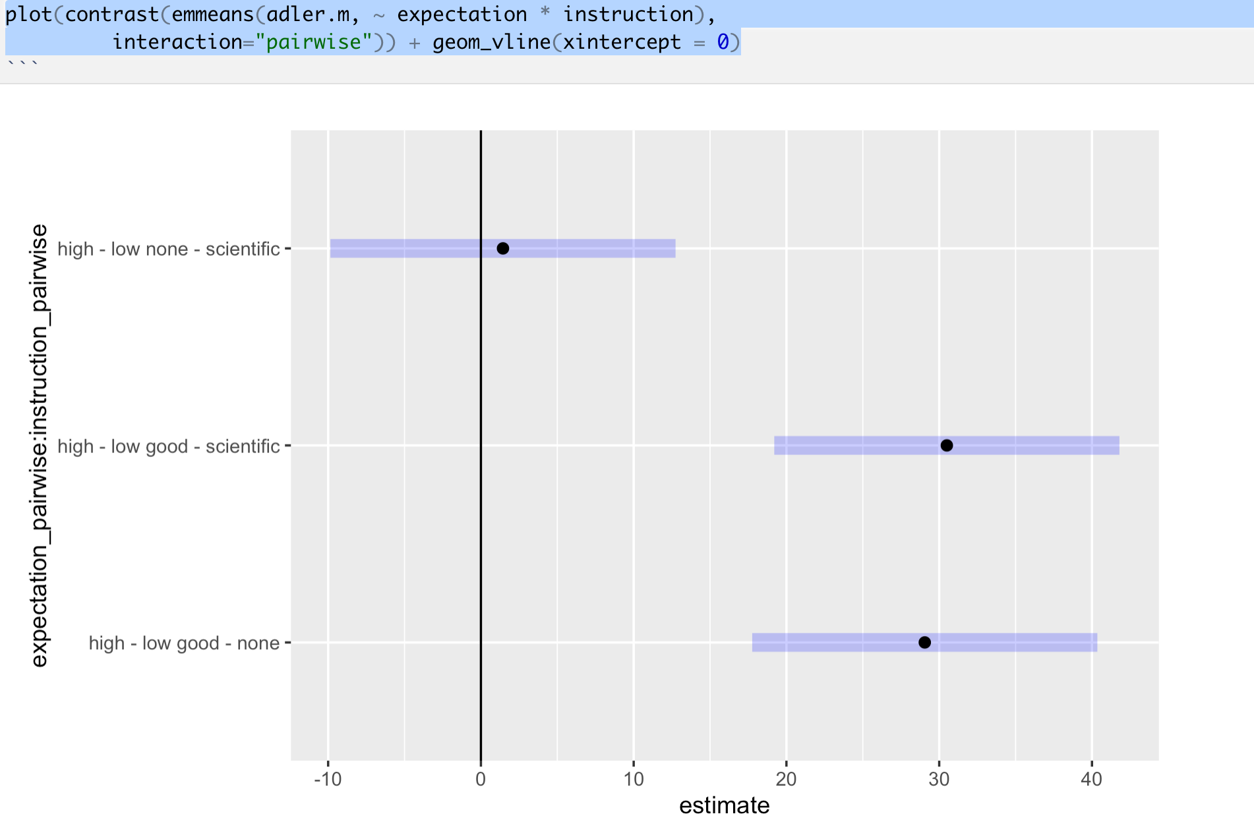
Differences in differences

Slide 12
Avoiding Bad bets and False discoveries

Slide 13
Fisher's conception of p values

Slide 14
Neyman & Pearson
“No test based upon a theory of probability can by itself provide any valuable evidence of the truth or falsehood of a hypothesis. But we may look at the purpose of tests from another viewpoint....
Notes:
Disliked subjectivity of Fisher’s approach to p values. Propose ‘hypothesis tests’. Designed as an objective, decision-based approach.
Motivated by a concern about Type II error (failing to reject the false null hypothesis).

Slide 15
Neyman & Pearson
“Without hoping to know whether each separate hypothesis is true or false, we may search for rules to govern our behaviour [which if followed ensure that] in the long run of experience, we shall not often be wrong.”

Slide 16
Fisher
“...in fact no scientific worker has a fixed level of significance at which from year to year, and in all circumstances, he rejects hypotheses; he rather gives his mind to each particular case in the light of his evidence and his ideas”
Notes:
Fisher calculated tables of critical values by hand at fixed alpha(s)
Pearson acknowledged critical-value tables a key contribution to the development of Neyman-Pearson theory
Emphasis on p < 0.05 rather than “exact” p-values was because of the need for manageable tables

Slide 17
Are we scientists or engineers?
Rules-based decisions?
Understanding informed by data?

Slide 18
Notes:
https://benwhalley.github.io/just-enough-r/multiple-comparisons.html
In frequentist statistics, p values are defined as *the probability of obtaining a test statistic at least as large as that observed, if the null hypothesis is true. That is, it’s the chance that the data we have collected are atypical and will mislead us into thinking there is a difference, when the true effect is zero.
Let’s pretend we are creative researchers and, over the course of our career, we will develop 100 hypotheses, each of which we test in an experiment, represented by squares in the plot below:
We are concientious and use sample size calculations for our studies, setting our desired power = .8, and use p = .05 as our criterion for rejecting the null hypotheses. As is common, we report tests which reject the null hypothesis as if our predictions had been supported, and the alternative hypotheses were true (this is a bad idea, but run with it for the moment).
Let’s be generous and say that, in reality, 50% of our hypotheses are true (the other 50% are nice ideas, but are not correct). Because we set our power to be .8 in our sample size calculation, this means that over the course of our career we will detect around 40 ‘true’ effects, and publish them. These are shown in blue in the figure below:

Slide 19
Half our predictions
are "true"
Power = .8
So publish 40 true
effects

Slide 20
Half our predictions
are "true"
Power = .8
So publish 40 true
effects
Also find 5 sig. but "null" effects
= 12.5%
Or if only 20% predictions true = 25% red.
Notes:
But what that means is that for the effects we publish as supporting our hypotheses (i.e. the blue and red squares) then we will be making false claims 5/40 = 12.5% of the time. This is obviously much higher than the nominal alpha level implies. What’s more, if we’re not hotshot theorists (or work in an area where theories are less rigorously developed) and only 20% of our hypotheses are in fact true then we will make even more false claims: 5/20 = 25%.

Slide 21
Allow for publishing "1 in 3" tests per study
= 37.5%.
Notes:
Another problem arises when we run multiple statistical tests on the same data.
The most common case is that we have multiple experimental conditions and want to test whether any of the differences between them are significant. If we had experimental 3 groups, then there are 3 possible comparisons between them, for example (A-B, A-C, B-C). This can be compounded if we have multiple outcome measurements (for example, measuring depression and anxiety in a clincal trial; see Feise (2002)).
This works like a lucky dip or lottery: if you buy more tickets you have a larger change of winning a prize. In this case, with three comparisons between the groups (tickets) we have a 15% chance of winning a prize, rather than the 5% we intended.
Assuming each of our 100 experiments allows for 3 tests, any of which would be ‘interesting’ if significant (and we would therefore publish them), then our plot looks like this: figure
And our ‘false discovery rate’ (at the level of our published papers) is now over one third: 15/40 = 37.5%.

Slide 24
Colquhoun 2014
Never, ever, use the word ‘significant’ in a paper. It is arbitrary, and deeply misleading.
If you do a significance test, just state the p-value and give the effect size and confidence intervals.
Observation of a p∼0.05 means nothing more than ‘worth another look’.
Do some rough calculations of the sample size that might be needed to show a worthwhile effect. Underpowered studies still abound and contribute to both high false discovery rates and effect size inflation.
If you want to avoid making a fool of yourself very often, do not regard anything greater than p<0.001 as a demonstration that you have discovered something.
Notes:
Never, ever, use the word ‘significant’ in a paper. It is arbitrary, and, as we have seen, deeply misleading. Still less should you use ‘almost significant’, ‘tendency to significant’ or any of the hundreds of similar circumlocutions listed by Matthew Hankins [17] on his Still not Significant blog.
— If you do a significance test, just state the p-value and give the effect size and confidence intervals. But be aware that 95% intervals may be misleadingly narrow, and they tell you nothing whatsoever about the false discovery rate. Confidence intervals are just a better way of presenting the same information that you get from a p-value.
— Observation of a p∼0.05 means nothing more than ‘worth another look’. In practice, one's attitude will depend on weighing the losses that ensue if you miss a real effect against the loss to your reputation if you claim falsely to have made a discovery.
— Do some rough calculations of the sample size that might be needed to show a worthwhile effect. Underpowered studies still abound and contribute to both high false discovery rates and effect size inflation.
— If you want to avoid making a fool of yourself very often, do not regard anything greater than p<0.001 as a demonstration that you have discovered something. Or, slightly less stringently, use a three-sigma rule.

Slide 25
One test/many tests
Colquhoun critique applies even if you do a single test
Problem is much worse if you make multiple comparisons

Slide 26
Sources of Multiple Comparisons
Groups
Subgroups
Time-points
Other repeat measures (e.g. voxels)
Measures
Coding schemes
AND Multiway Anova (main effects + interactions, Cramer 2016)

Slide 27
People worry about "doing it right"
Rothman 1990
… when there is a strong basis for believing the results to be true then they are wasteful
Rothman, K. J. (1990). No adjustments are needed for multiple comparisons. Epidemiology 1 (1), 43–46.
Complacent?
Easy to collect data
Easy to fish
Exploratory analyses
No strong priors
Colquhoun, D. (2014). An investigation of the false discovery rate and the misinterpretation of p-values. Royal Society Open Science, 1(3), 140216. https://doi.org/10.1098/rsos.140216

Slide 28
Multiplicity in multi-way Anova
2x2 = 3 tests
Main effect A
Main effect B
Interaction
Cramer, A. O. J., Ravenzwaaij, D. van, Matzke, D., Steingroever, H., Wetzels, R., Grasman, R. P. P. P., … Wagenmakers, E.-J. (2016). Hidden multiplicity in exploratory multiway ANOVA: Prevalence and remedies. Psychonomic Bulletin & Review, 23(2), 640–647. https://doi.org/10.3758/s13423-015-0913-5
See also http://deevybee.blogspot.co.uk/2013/06/interpreting-unexpected-significant.html

Slide 29

2 questions:
What do you care about?
How big is the 'family' of tests?
Notes:
Inevitably, it depends!
If your worry is ever making a type 1 error then you need to control the familywise error rate. The Bonferroni or Tukey correction are likely the best solutions (see details below). Both have the disadvantage of increasing the type 2 error rate: you will falsely accept the null more frequently, and so neglect findings which are ‘true’ and might be theoretically or clinically relevant.
If your main concern is about the number of ‘false discoveries’ you make, and you think it’s import to you to avoid rejecting ‘good’ hypotheses, then you need a technique to control the false discovery rate. The Benjamini and Hochberg method, often abbreviated as BH or FDR correction, is what you need.

Slide 30
What do you care about?
No. Type 1 errors/ever being wrong (red squares)
Anova (to a point)
Bonferroni, Holm-Bonferroni
(Strict) Pre-specification
False discovery rate/"looking wrong" (ratio of blue to red)
FDR correction (Benjamini and Hochberg)
None of the above
Don't make decisions?
Only publish in Psychological Science?
Go Bayesian?
Notes:
Which technique?
Inevitably, it depends!
If your worry is ever making a type 1 error then you need to control the familywise error rate. The Bonferroni or Tukey correction are likely the best solutions (see details below). Both have the disadvantage of increasing the type 2 error rate: you will falsely accept the null more frequently, and so neglect findings which are ‘true’ and might be theoretically or clinically relevant.
If your main concern is about the number of ‘false discoveries’ you make, and you think it’s import to you to avoid rejecting ‘good’ hypotheses, then you need a technique to control the false discovery rate. The Benjamini and Hochberg method, often abbreviated as BH or FDR correction, is what you need.
Principled arguments can be made for both approaches; there is no ‘correct choice’. Which you pick will depend on which concerns are most pressing to you, and also (inevitably) what is conventional in your field.

Slide 31
Anova and omnibus tests
You use a factorial Anova:
F test provides some protection if you:
Only explore pairs after significant F test
Have a clear idea of which pairs are important
If you're somewhat interested in any pairing then … eek!
AND, multiplicity inherent in multiway Anova itself

Slide 32
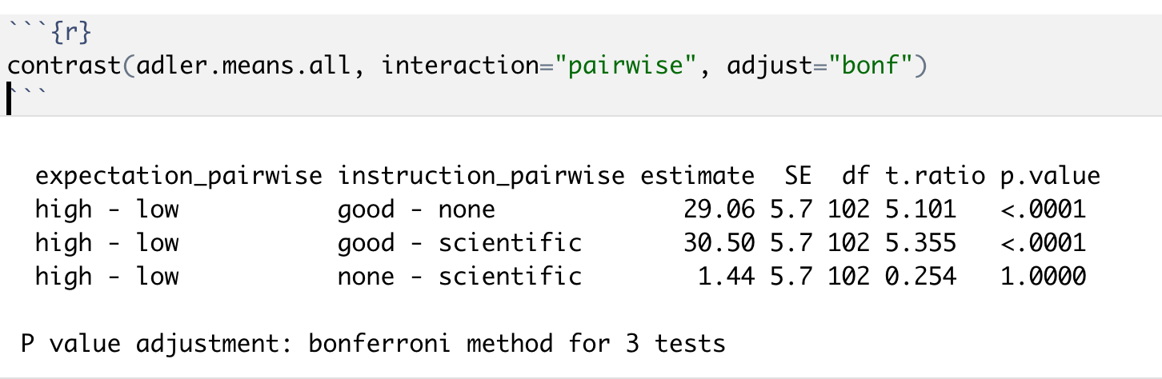
Bonferroni/FDR methods
In R
pvals <- c(.01,.049, .011)
p.adjust(pvals, method="bonf")
p.adjust(pvals, method="holm")
p.adjust(pvals, method="fdr")
Simple explanation of FDR correction http://www.statisticshowto.com/benjamini-hochberg-procedure/ see also http://www.biostathandbook.com/multiplecomparisons.html

Slide 33
How big is the family? Feise 2002
It is unclear how wide the operative term “family” should be […]
Does “family” include tests that were performed, but not published? Does it include a meta-analysis upon those tests? Should future papers on the same data set be accounted for in the first publication?
Should each researcher have a career-wise adjusted p-value, or should there be a discipline-wise adjusted p-value?
Should we publish an issue-wise adjusted p-value and a year-end-journal-wise adjusted p-value?
Should our studies examine only one association at a time, thereby wasting valuable resources?
No statistical theory provides answers for these practical issues, because it is impossible to formally account for an infinite number of potential inferences.
Notes:
Feise, Ronald J. 2002. “Do Multiple Outcome Measures Require P-Value Adjustment?” BMC Medical Research Methodology 2 (1). BioMed Central: 8.

Slide 34
Family size
p.adjust(.014, method="bonf", n=2)
p.adjust(.014, method="bonf", n=3)
p.adjust(.014, method="bonf", n=10)

Slide 35
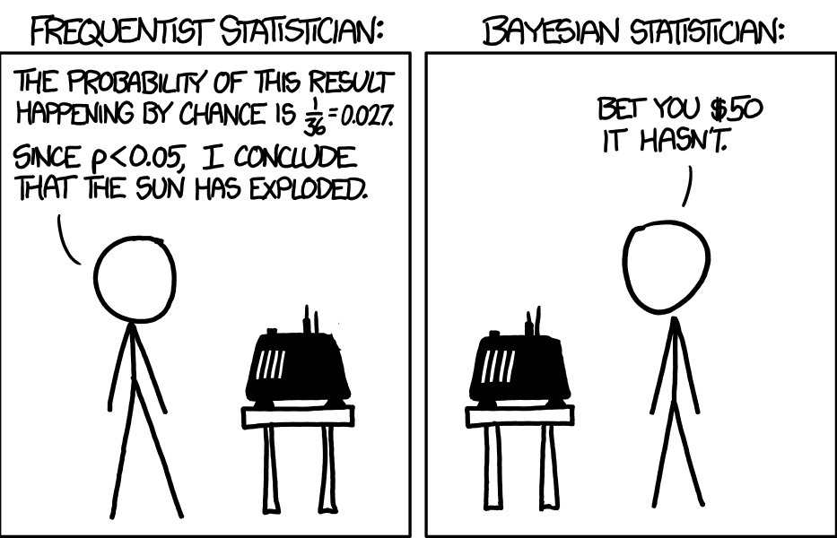
Double standards?
Researcher 1: It's a really interesting 3X2 experiment, but we don't have a strong sense of what will happen (Family = 15)
Researcher 2: I’m only interested in the 3 ‘difference in difference’ comparisons (Family=3)
Reseacher 3: I'm only interested in this specific 3 way interaction… A>B but only if C. (Family = 1)
Does adjustment depend on your intentions? Is that OK?

Slide 36
George Soros
How much is there to lose in your field by being wrong? Can you contrast that with another area of psychology/research?
It is not whether you are right or wrong that is important, but how much money you make when you are right, and how much you lose when you are wrong.
The ‘cost’ of your decision should also be a factor.

Slide 37
Pragmatically, the family might be:
“All of the tests you might have been interested in from a given model/experiment/paper.”
Best if you can specify this up front
Notes:
Exercise to look at Abstract of morriss-specialist-depression-rct.pdf

Slide 38
Advice
You are balancing two objectives:
You need to get published/noticed
You don't want to waste your time
Think about power explicitly
Plan comparisons a prior
Report sensitivity analyses
Adjust for FWER or FDR

Slide 39
Sensitivity analysis example
Multiple Testing and Post Hoc Tests.
The multiple regression associations were the most robust; Δd′ advantage associated with predominance of hallucination-proneness and disadvantage in Δd′ and Δv associated with predominance of delusion-proneness remained significant when corrected for 5% false discovery rate. Our other results did not survive this correction and should thus be considered preliminary.
Davies, D. J., Teufel, C., & Fletcher, P. C. (2017). Anomalous Perceptions and Beliefs Are Associated With Shifts Toward Different Types of Prior Knowledge in Perceptual Inference. Schizophrenia Bulletin.
Notes:
https://academic.oup.com/schizophreniabulletin/advance-article/doi/10.1093/schbul/sbx177/4779898

Slide 40
Exercises
Hierarchical multiple regression
Pairwise contrasts
Interaction contrasts
P value adjustment

